Slide 1
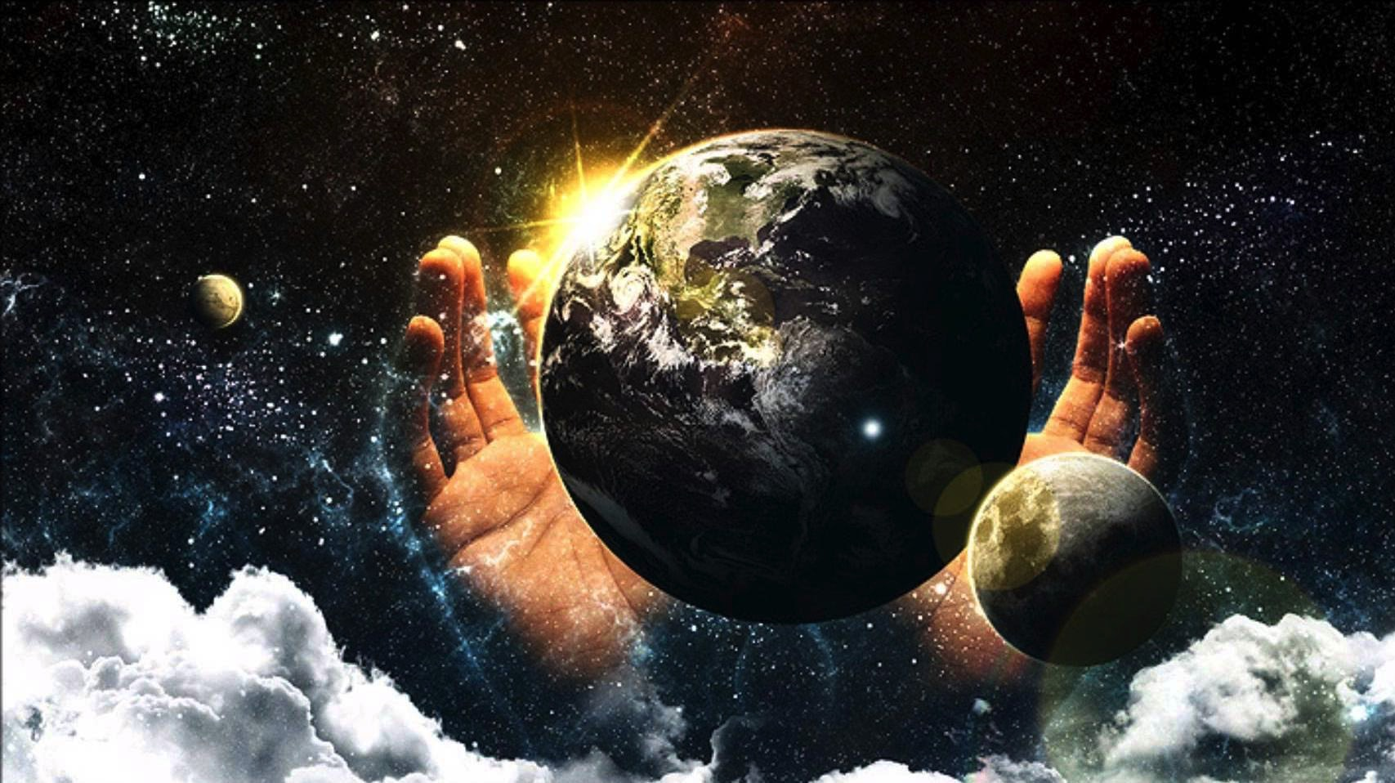
Eeny-meeny-miny-moe?
Genesis 25:19-26
Designed and Preached by Student Daniel Gan Uploaded by Dr. Rick Griffith • Singapore Bible College All files in many languages for free download at BibleStudyDownloads.org

Slide 2
FIRED
bankrupt
WHERE IS GOD?
CANCER
DIVORCE
Losing my children

Slide 3
Eeny-meeny-miny-moe?

Slide 4
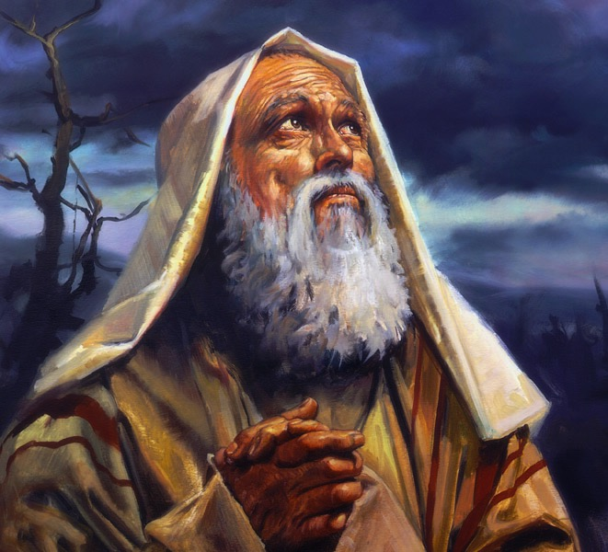
Genesis 12:2-3 (NIV)
“I will make you into a great nation and I will bless you;
I will make your name great, and you will be a blessing. I will bless those who bless you and whoever curses you I will curse; and all peoples on earth will be blessed through you.”

Slide 5
Genesis 25:19-26
This is the account of the family line of Abraham’s son Isaac.
Abraham became the father of Isaac, and Isaac was forty years old when he married Rebekah daughter of Bethuel the Aramean from Paddan Aram and sister of Laban the Aramean.
Isaac prayed to the Lord on behalf of his wife, because she was childless. The Lord answered his prayer, and his wife Rebekah became pregnant. The babies jostled each other within her, and she said, “Why is this happening to me?” So she went to inquire of the Lord.
The Lord said to her,
“Two nations are in your womb, and two peoples from within you will be separated; one people will be stronger than the other, and the older will serve the younger.”
When the time came for her to give birth, there were twin boys in her womb. The first to come out was red, and his whole body was like a hairy garment; so they named him Esau. After this, his brother came out, with his hand grasping Esau’s heel; so he was named Jacob. Isaac was sixty years old when Rebekah gave birth to them.

Slide 6
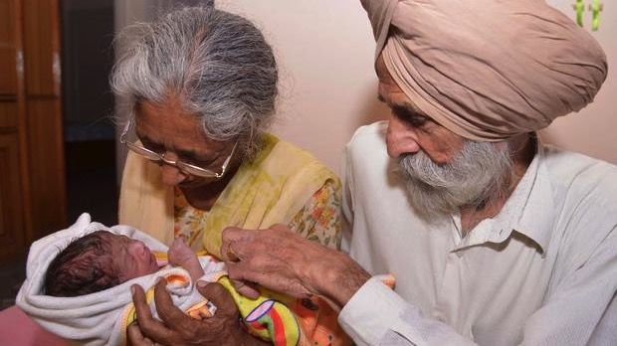
Maria del Carmen Bousada de Lara

Slide 7
GOD KEEPS HIS PROMISES

Slide 8
Romans 4:3
What does Scripture say? "Abraham believed God, and it was credited to him as righteousness."

Slide 9
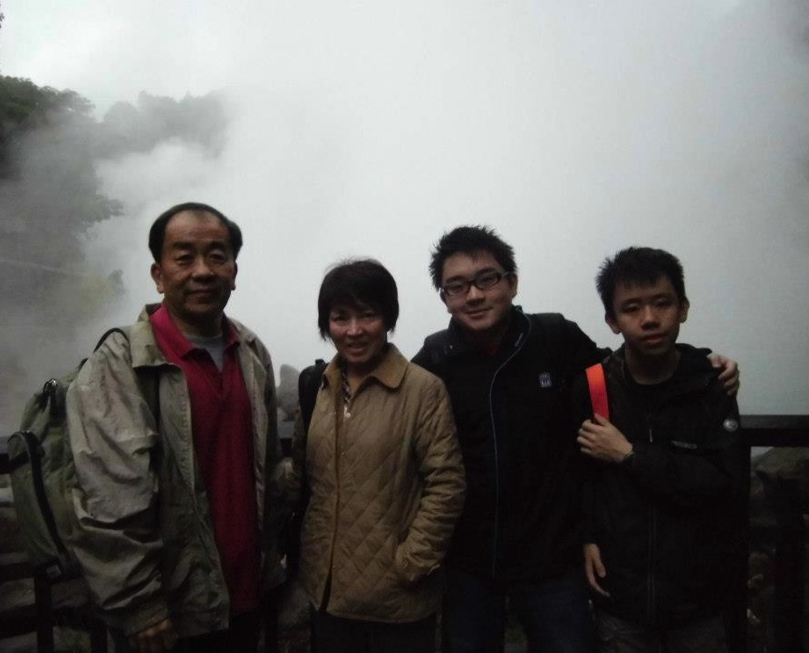

Slide 10
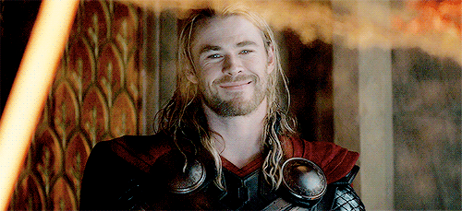

Slide 12
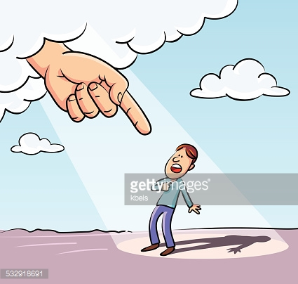
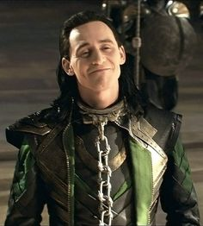
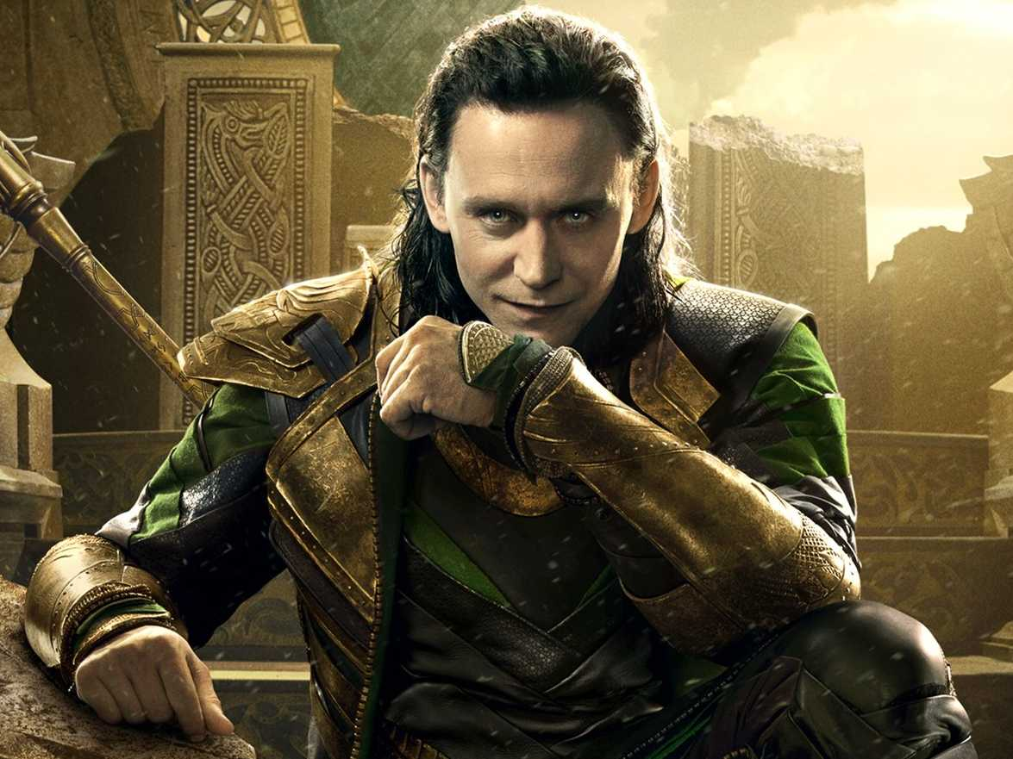

Slide 13
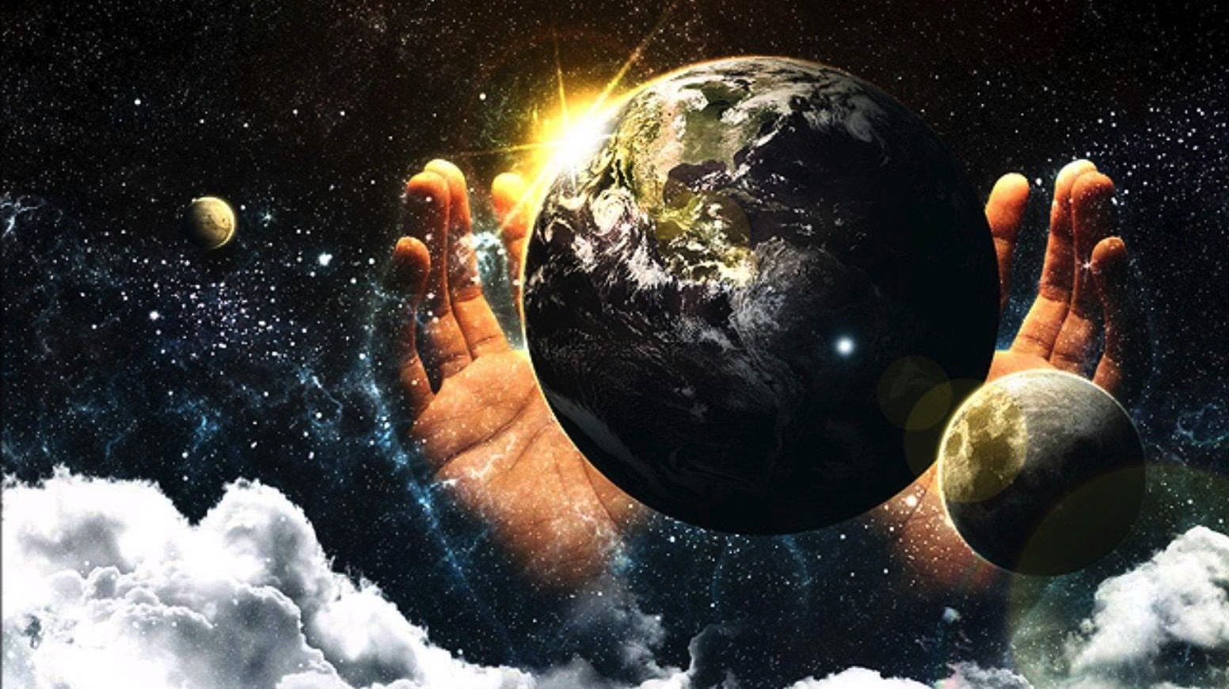
GOD KEEPS HIS PROMISES BUT BY HIS WILL/CHOICE

Slide 15
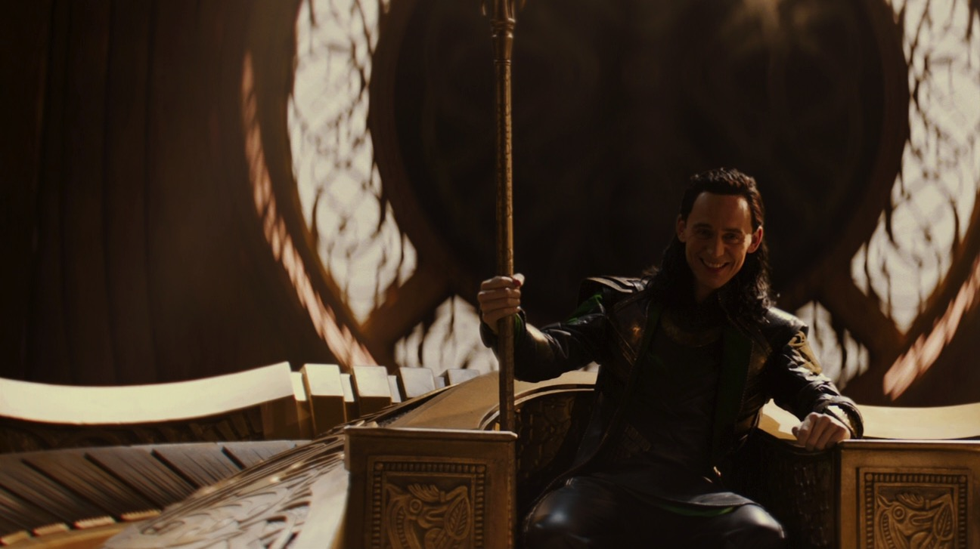
Romans 9:14-16 (NIV)
What shall we say? Is God unjust? Not at all! For he says to Moses,
“I will have mercy on whom I have mercy, and I will have compassion on whom I have compassion.”
It does not, therefore, depend on man’s desire or effort, but on God’s mercy.
Eeny-meeny-miny-moe?

Slide 16
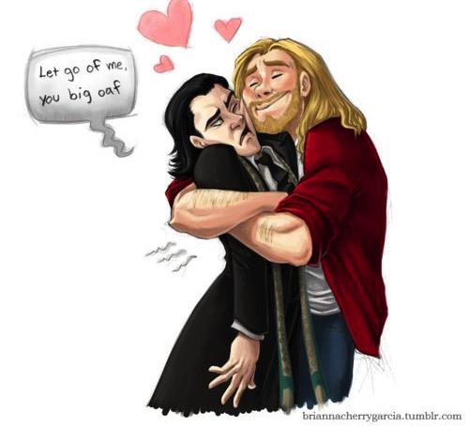
Romans 8:28 (NIV)
“And we know that in all things God works for the good of those who love him, who have been called according to his purpose.”

Slide 17
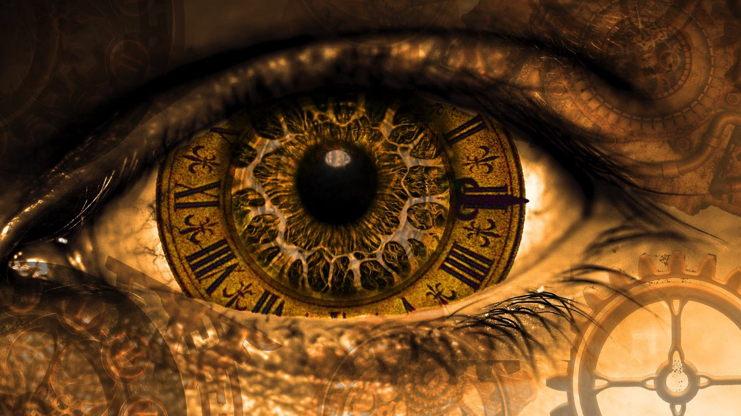
2 Peter 3:8 (NIV)
But do not forget this one thing, dear friends: “With the Lord a day is like a thousand years, and a thousand years are like a day.” The Lord is not slow in keeping his promise, as some understand slowness. Instead he is patient with you, not wanting anyone to perish, but everyone to come to repentance.

Slide 18
GOD KEEPS HIS PROMISES IN HIS TIME

Slide 19
FIRED
bankrupt
WHERE IS GOD?
CANCER
DIVORCE
Losing my children

Slide 20
POWERFUL
faithful
HERE I AM.
SOVEREIGN
LOVES
wants the best for us

Slide 22
OT Preaching link at BibleStudyDownloads.org
Get this presentation and script for free!
Notes:
OT Preaching (op)

